Slide 1
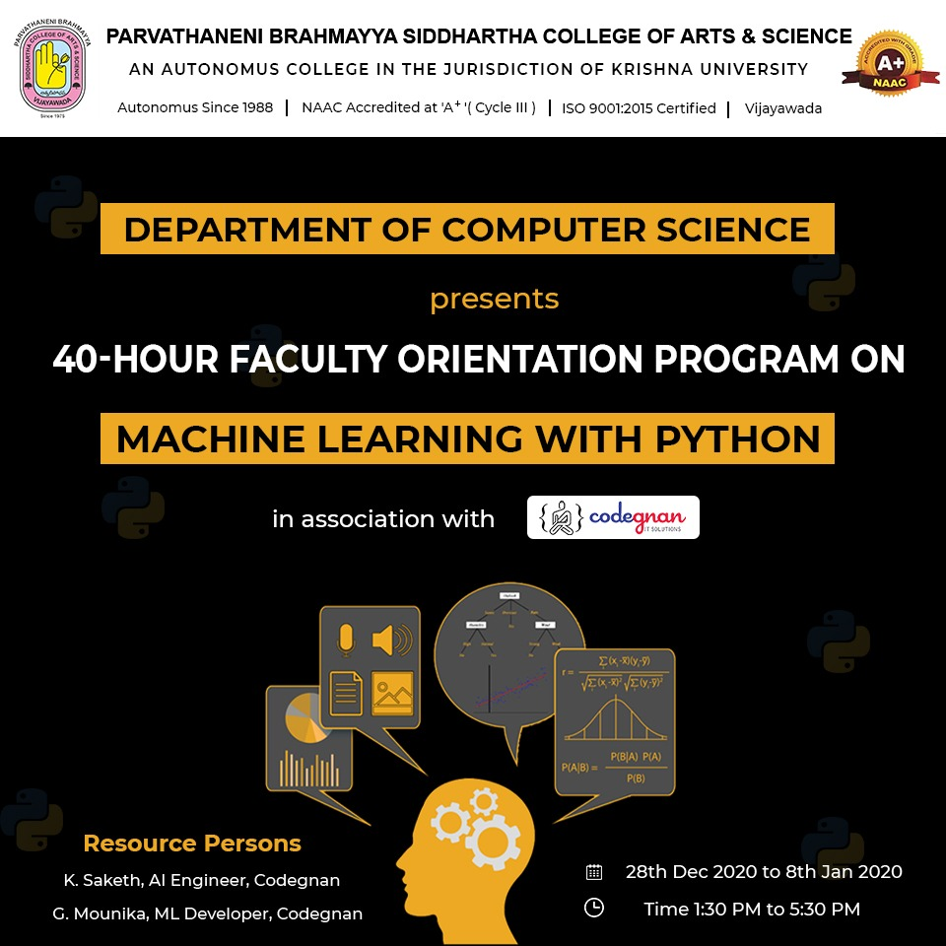
Start..

Slide 2
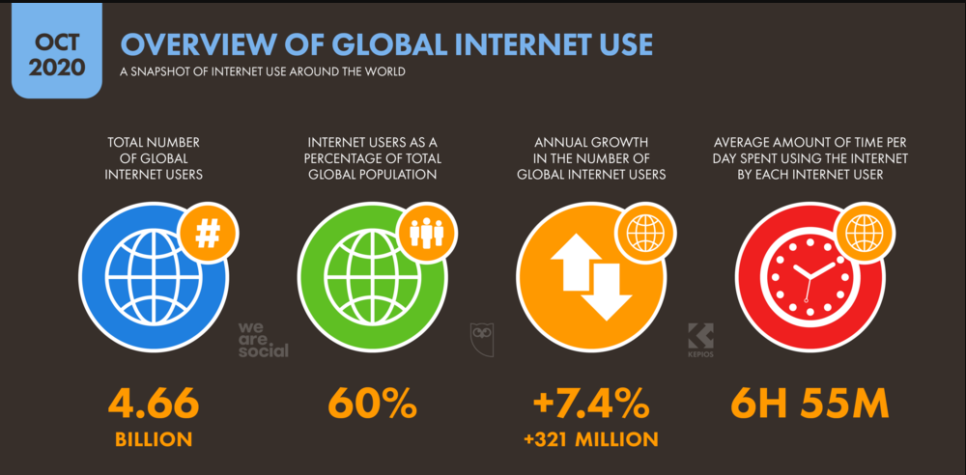

Slide 3
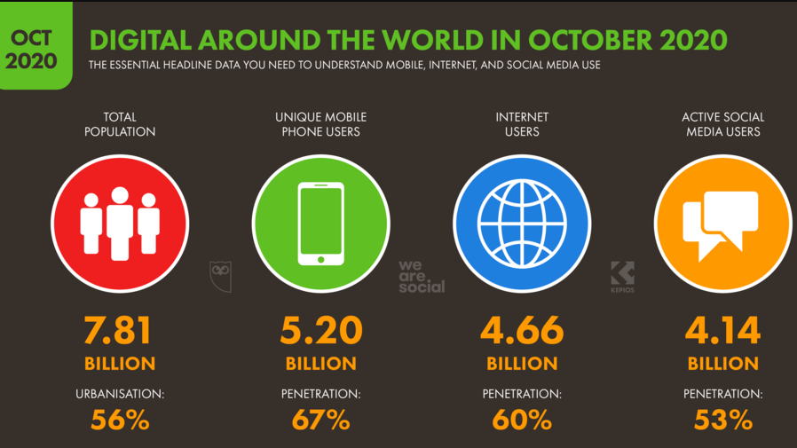

Slide 4
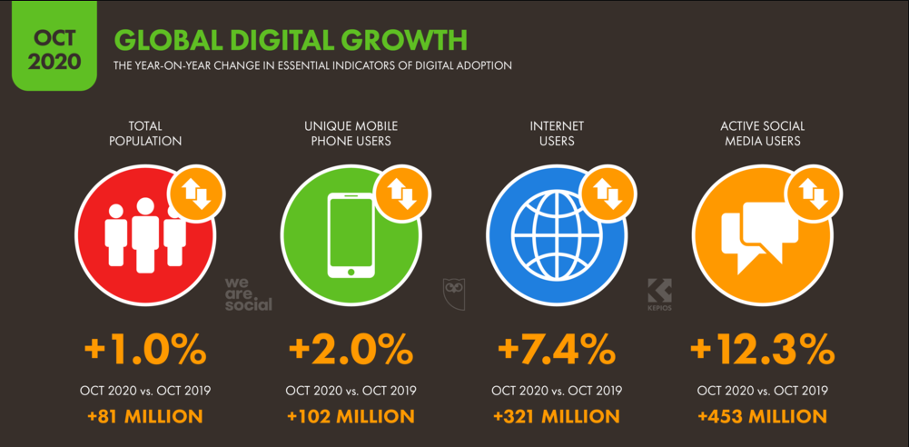

Slide 5
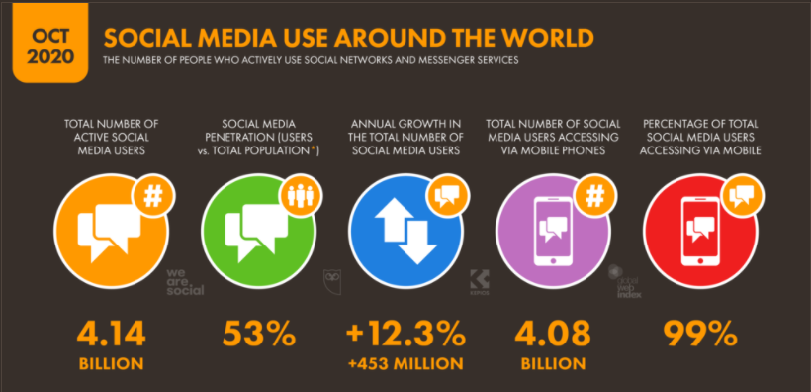

Slide 6
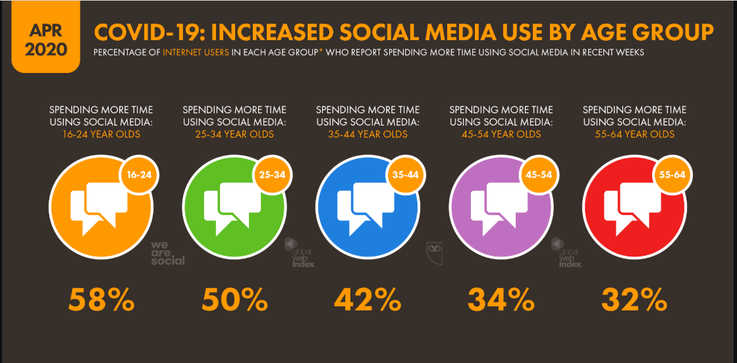

Slide 7
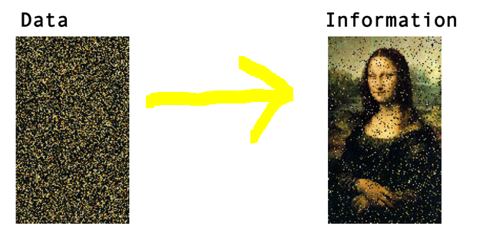
Data vs Information
Data can be any character, number, images, word text which is raw and unorganized.
It can be considered as raw facts, which is input to the computer.
Whereas Information is created from data.
It is an output from a Computer
Data alone can never be significant. But information is always important by itself

Slide 8
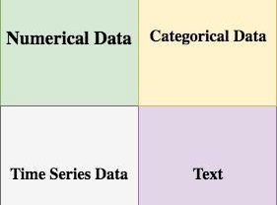
Data
Data might be of any form. Broadly it is categorized as:
Qualitative(Categorical) and Quantitative(Numeric)
Nominal and Ordinal,
Interval and Ratio.

Slide 9
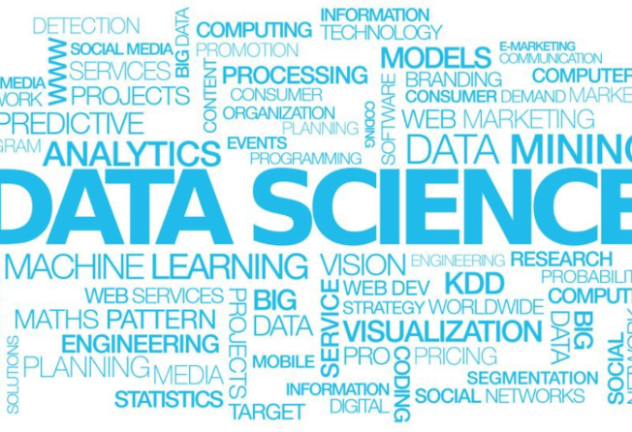
Buzz word of 21st Century “Learning from data is virtually useful. Master it and you will be welcomed anywhere.”

Slide 10
Categories of Data:
Structured Data - Well organized data in the form of Tables
Semi-Structured Data - A structured data that is unorganised.
Unstructured Data – It requires advance tools and software’s to access information

Slide 11

“AI is akin to building a rocket ship. You need a huge engine and a lot of fuel. If you have a large engine and a tiny amount of fuel, you won’t make it to orbit. If you have a tiny engine and a ton of fuel, you can’t even lift off. To build a rocket you need a huge engine and a lot of fuel. The rocket engine is the learning algorithms, but the fuel is the huge amounts of data we can feed to these algorithms”

Slide 12
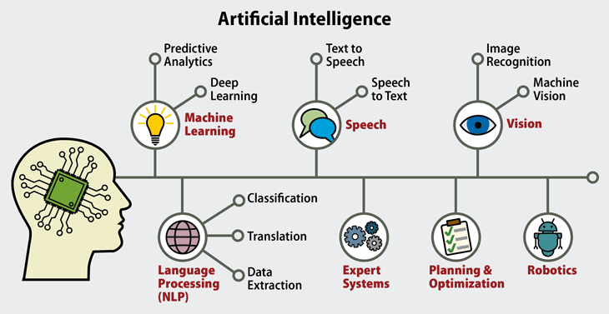

Slide 13
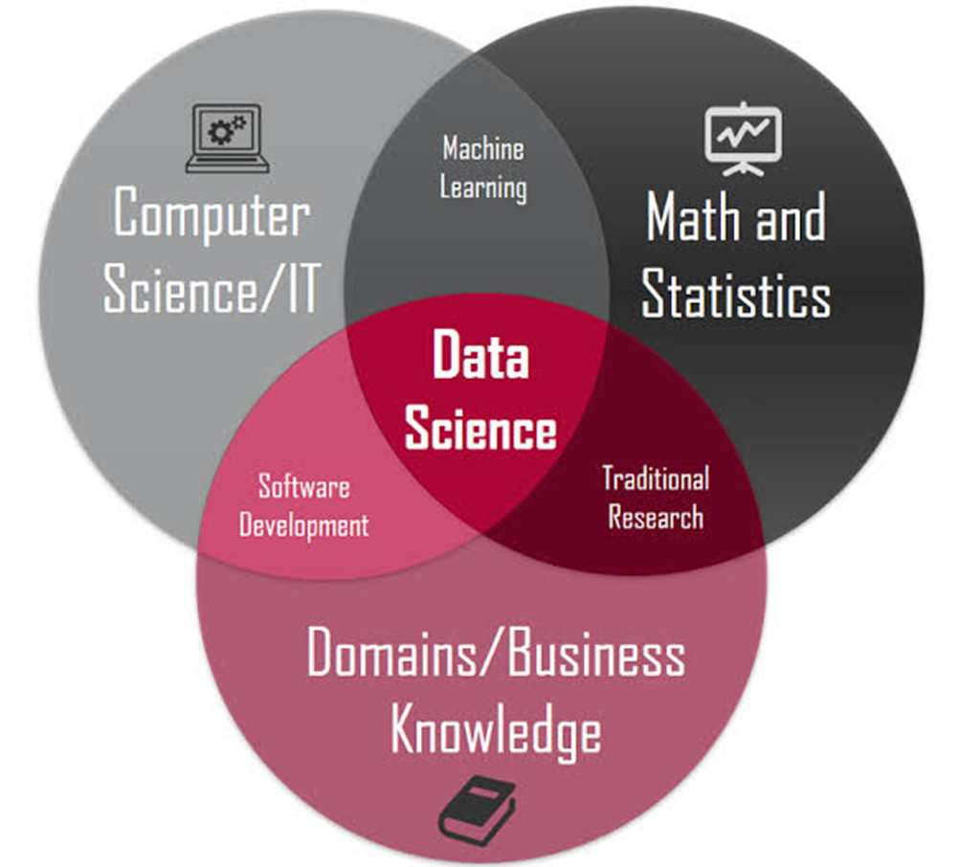
“Data Science is a multidisciplinary field to extract knowledge and insights from data.”
Data is like a crude and unpolished Diamond, which needs to be polished or cleansed for future use

Slide 14
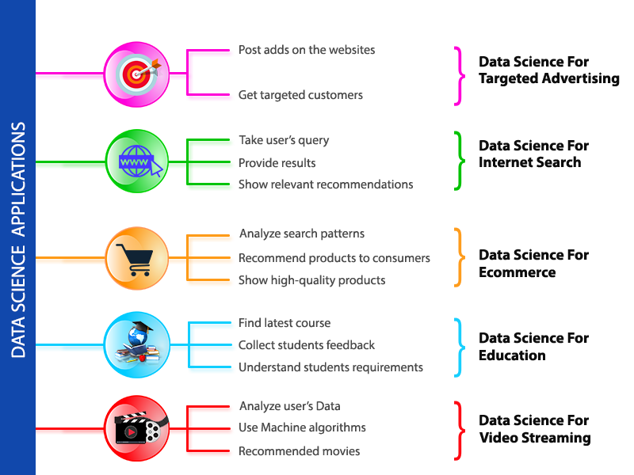
USE CASES

Slide 15
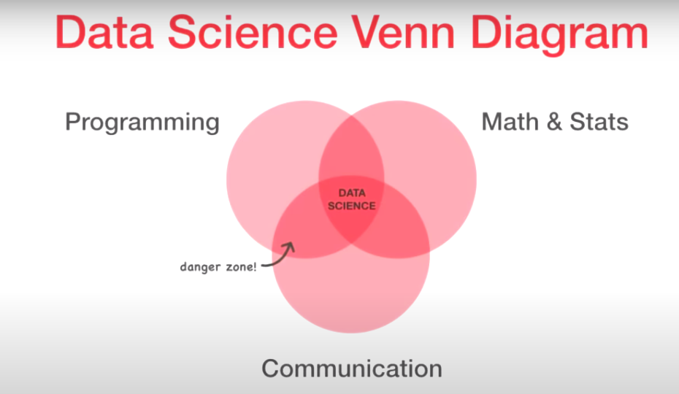

Slide 16
Data Science vs Artificial Intelligence
Data Science is a concept used to tackle big data and includes data cleansing, preparation, and analysis. A data scientist gathers data from multiple sources and applies machine learning, predictive analytics, and sentiment analysis to extract critical information from the collected data sets.
Artificial Intelligence aims at enabling machines to execute reasoning by replicating human intelligence. Since the main objective of AI processes is to teach machines from experience, feeding the right information and self-correction is crucial.
AI experts rely on deep learning and natural language processing to help machines identify patterns and inferences.

Slide 17
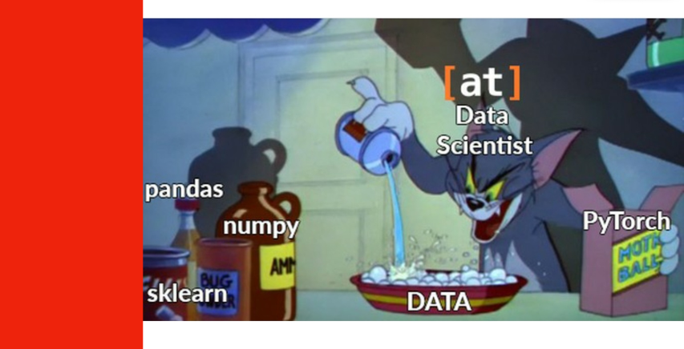

Slide 18
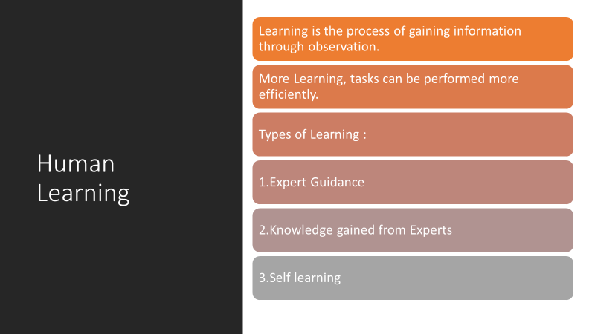

Slide 19


Slide 20


Slide 21


Slide 22
Has been in the picture from the past 50 years
Initially coined by Arthur Samuel in the year 1959 as Field of Study that gives computers the ability to learn without being explicitly programmed.
It was not that significant as of today 22 years ago.
Best definition by Tom Mitchell -A Computer Program is said to learn from experience "E" with respect to some class of tasks "T" and performance measure "P", If its performance at tasks in "T“ as measured by "P", improves with experience "E".
Machine Learning

Slide 23
22 years ago IBMs Deep Blue beat World Chess Champion Gary Kasparov, which marked the importance and gave people a serious attention.
Then in the 21st century everything has seen exponential growth in the development and applications.
2006 marked the word Deep Learning by publications made by Geoffrey Hinton from the concept of Deep Belief Nets.
2011 IBM Watson beat Human champions in Jeopardy.
Google started Brain Team and X Lab.
2014 FaceBook Face Tagging (DeepFace)
2016 Google’s Alpha Go beat Professional Players in Go game.
2017 - 2019 Self Driving Cars and Tensorflow influence.
Attention

Slide 24
Did you know?
Machine learning saves life - ML can spot 52% of breast cancer cells, a year before patients are diagnosed
US Postal Service uses machine learning for handwriting recognition
Facebook’s News Feed uses machine learning to personalize each members feed.
Uttar Pradesh has deployed AI-enabled video analytics platform “Jarvis” in 70 prisons to monitor inmates.

Slide 25


